Slide 1
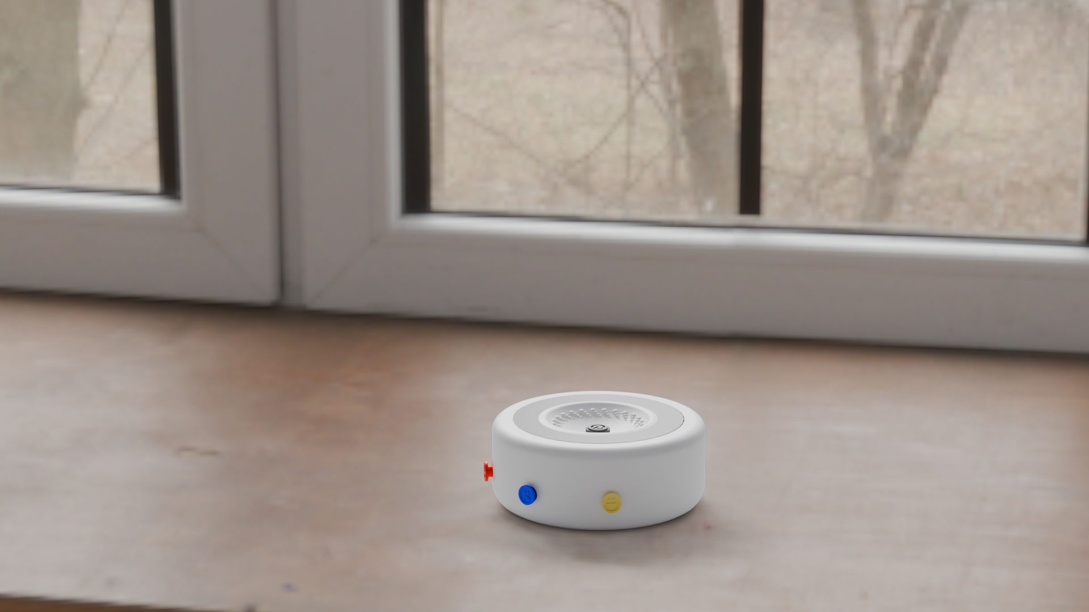
Aligned
Navigate & Communicate Feelings
Dankao Chen
Youtian Peng
Jiaying Shen
TINA SAMIE
NEXT
Presented by: Group 2
Date: 24/03/2025

Slide 2
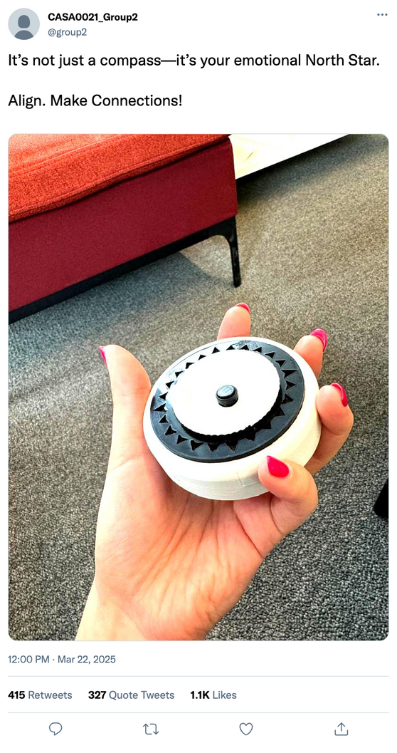
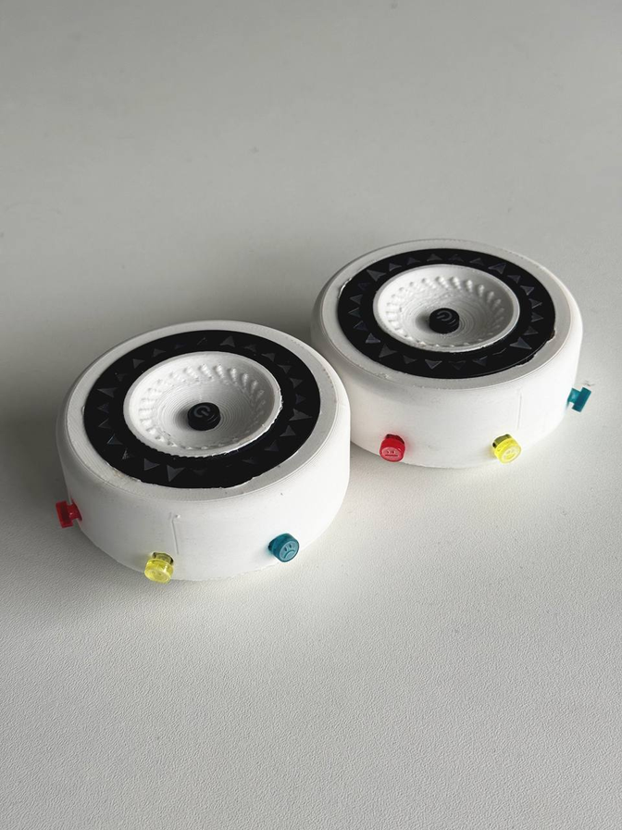
What
Is Aligned?
NEXT
2025
Aligned

Slide 3
ALIGNED
VIDEO INTRO
WHAT IS ALIGNED?
06
PHOTO GENERATED USING COPILOT

Slide 4
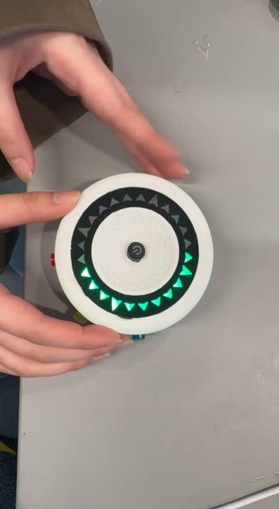



ALIGNED
Device 1
Device 2
01
Navigate to align
01
You have a message!
Using your compass slowly turn to find the right angle to face to your partner
The device lights up to indicate a connection request
02
Select a mood
02
Navigate to align
06
Choose the mood that you want to express to the other person using buttons
Using your compass slowly turn to find the right angle to face to your partner
03
Aligned!
03
Aligned!
Wait for your partner to get aligned as well ! Your device will turn to the color of your mood if they are aligned showing that the message is received!
When you successfully aligned with your partner you will get the mood they are in with the color of the light change to match their mood!
PHOTO GENERATED USING COPILOT

Slide 5
WHO NEEDS ALIGNED?

Slide 6
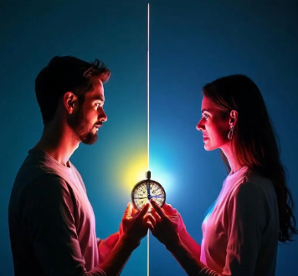
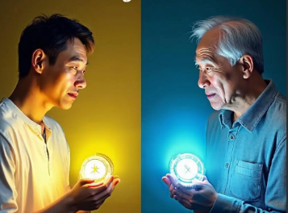

ALIGNED

Slide 7
ALIGNED
Challenge: Time zone differences create emotional disconnect.
Scenario: Sending rainbow light pulses to show “i’m happy!” when physical presence isn't possible.
Insight: "83% of long-distance couples experience reduced anxiety through visual emotion synchronization. "
Synthesis of findings from Chien's longitudinal study (2017) and Gartner 2024 tech-adoption data
"Love is not about being in the same place, but being aligned in feelings“

Slide 8
ALIGNED
Challenge: The fading glow of distant friendships.
Scenario: Sending synchronized light effects when feels lonely across time zones.
Insight: "59% of long-distance friends believe light-based rituals maintain bonds"
Synthesized from MIT Media Lab's ambient intimacy studies (2021) and Pew Research Center's digital friendship report (2023)
“Shared joy doubles, shared sorrow halves - when hearts are ALIGNED”

Slide 9
ALIGNED
Challenge: Generational emotional translation gaps
Scenario: Projecting rainbow waves on Father's Day to bridge unspoken bonds.
Insight: Nonverbal signals increase the frequency of parent-child deep conversations by 53%
Synthesized from APA's family communication studies (2020) and Fatherhood Institute's tech-adoption report (2023)
“Silent love finds its voice through ALIGNED’s light”

Slide 10



Extended user groups
Nonverbal communication in families with autism
Mood warning system for people with depression
Emotional Radar in Business Negotiations

Slide 11
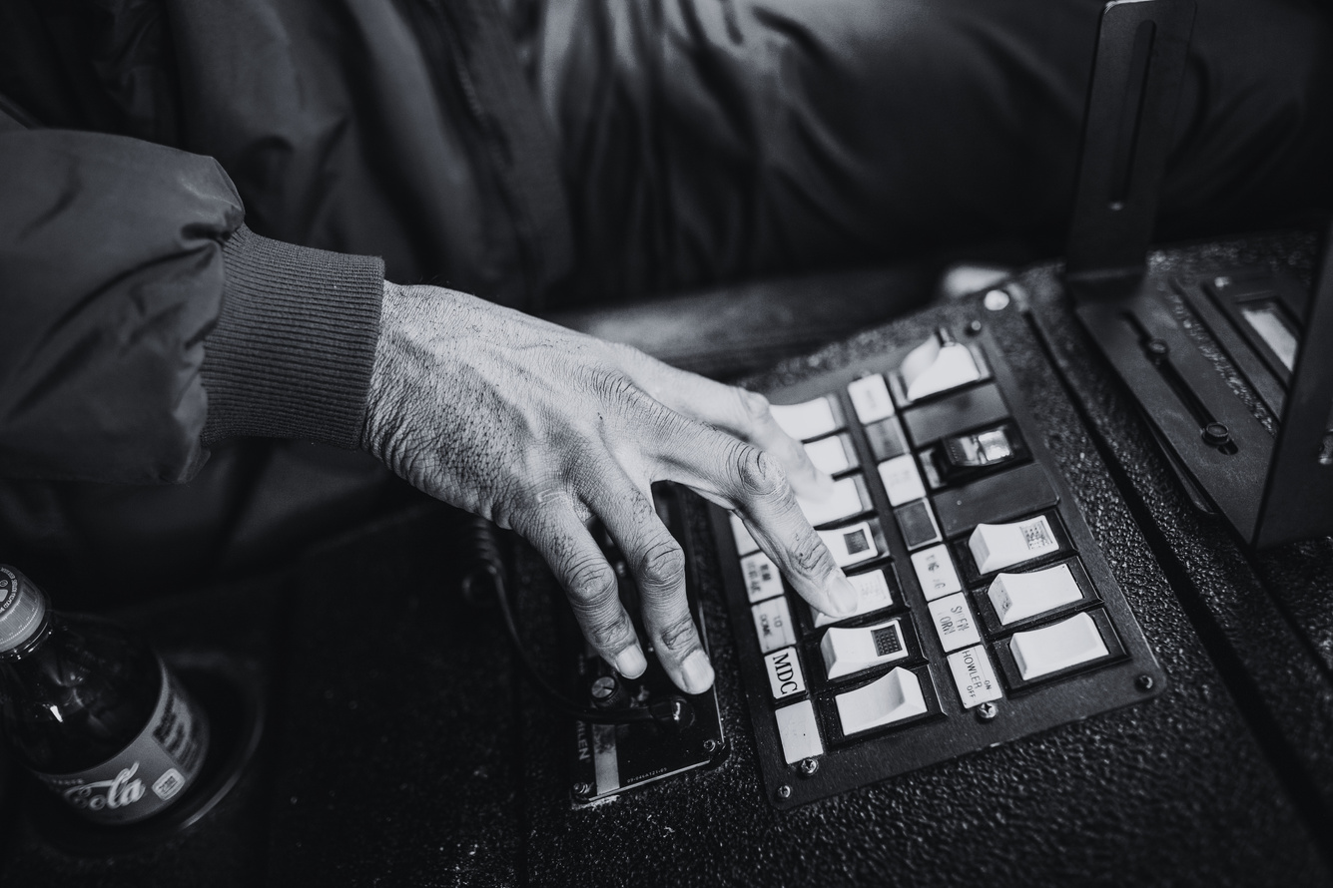

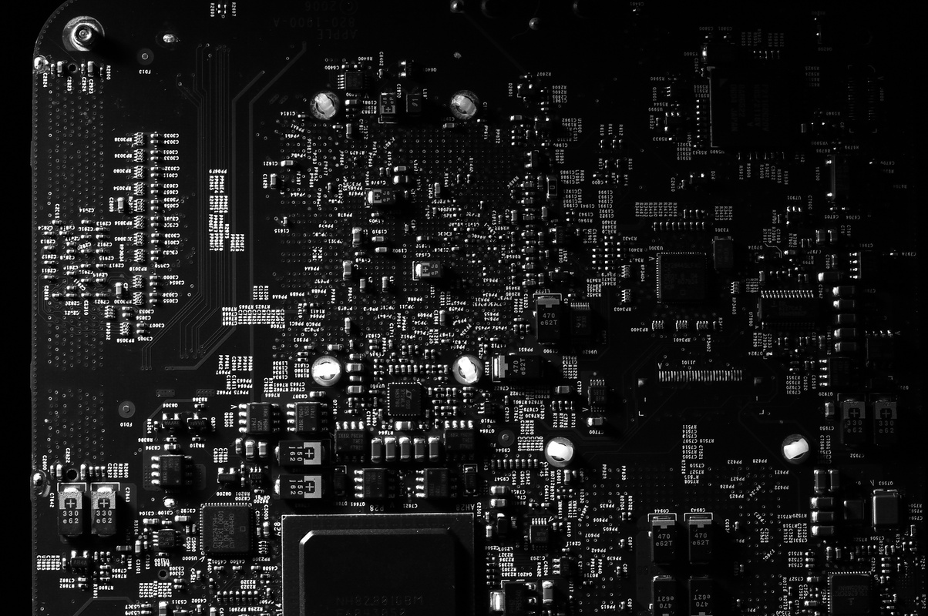

Function Iteration
Design Overview
Hardware Setup
Enclosure Design
Development Roadmap
NEXT

Slide 12
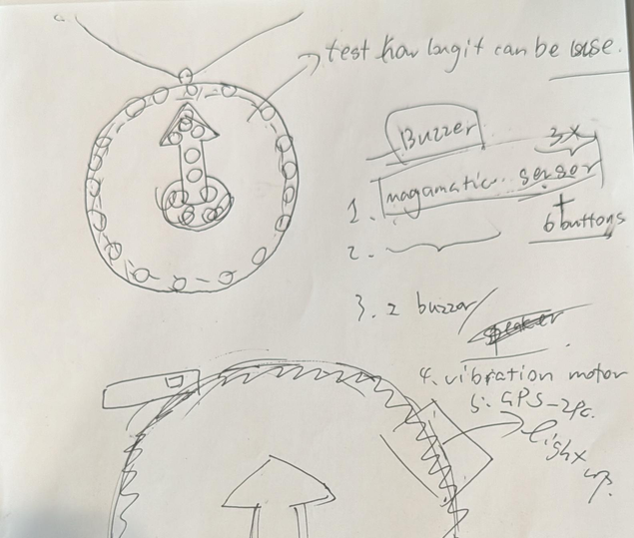
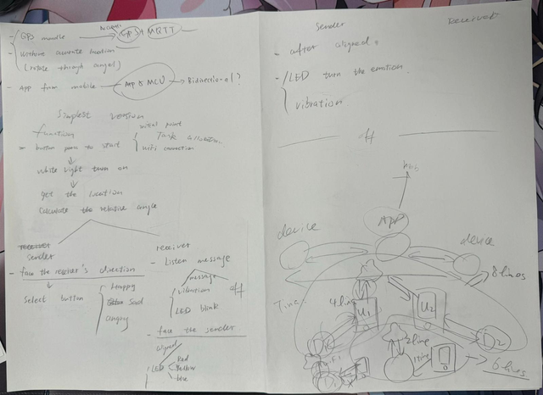
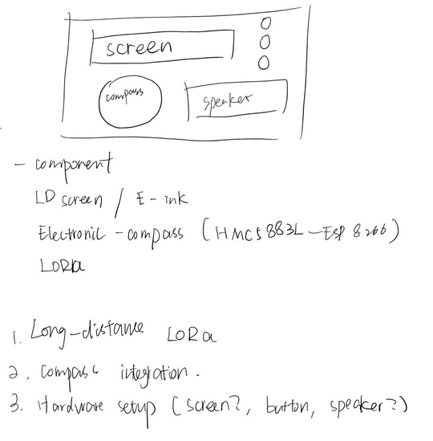
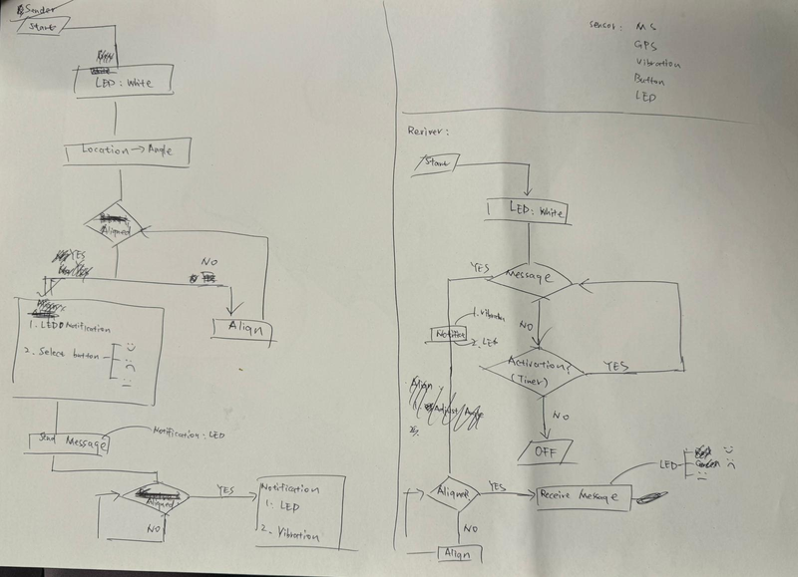
Design Iteration
Spatial perception
emotional communication
gamification

Slide 13
Function Comparison
Similar Product | Unique Point | Limitation
Suunto | Able to navigate User frindly Small size | Not able to deliver emotional transmission
Lovebox | Emotional transmission and interaction visual feeling | Not very much human interaction app based device USB based device
Hey Bracelet | High privacy Emotional transmission Small size device | touch feeling only

Slide 14
What does our device enable?
💌 Transmit emotional messages
Users can send emotional signals (happy, sad, angry) via directional communication
👀👂🤲 Multi-sensory feedback
Integrates visual, haptic (vibration), and sound cues to enhance the experience.
🧍‍♂️↔️🧍‍♀️ Human-centered interaction
Encourages face-to-face-like engagement by requiring users to align directionally.
🔐 High privacy
Messages are only revealed when the receiver faces the correct direction, protecting emotional content.
🔋 Chargeable and portable
Small device powered by a rechargeable battery with USB charging support.

Slide 15
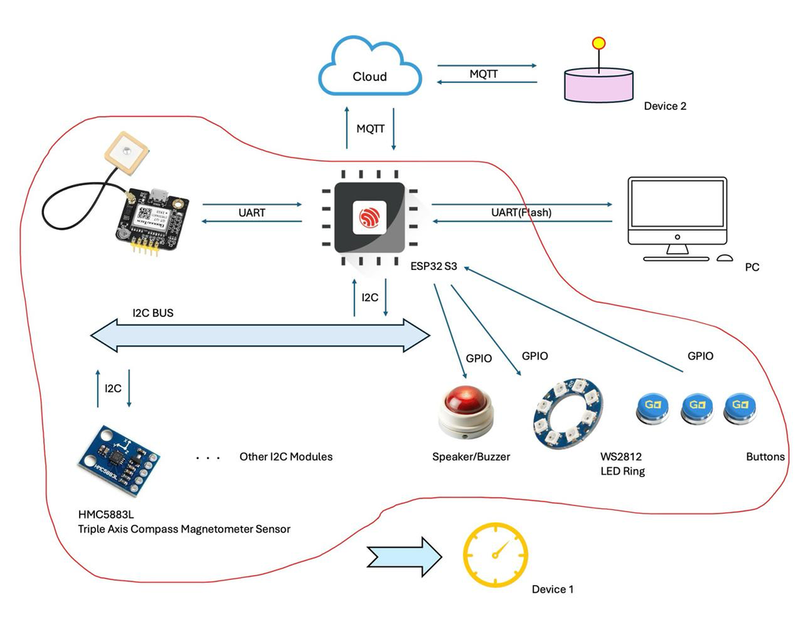
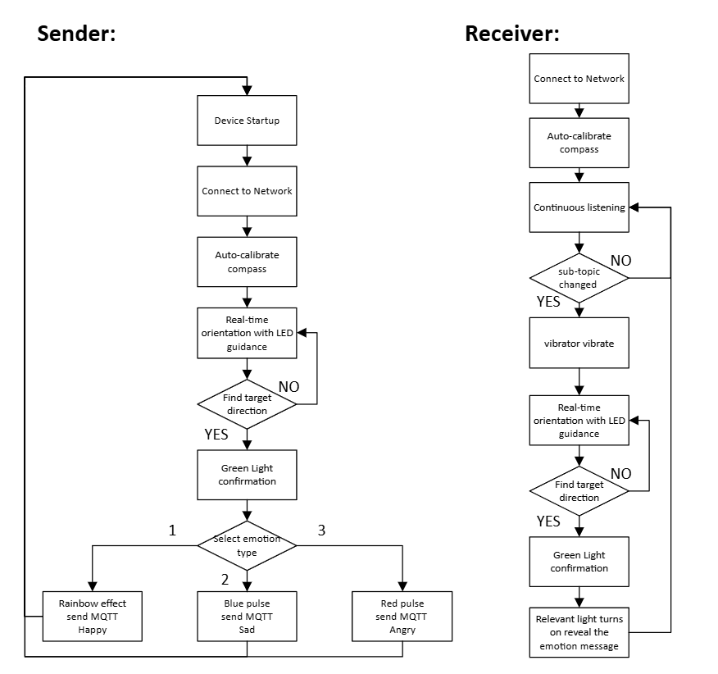
Both devices can function as either a sender or a receiver
Deal with each other's emotional events at the same time
NEXT

Slide 16
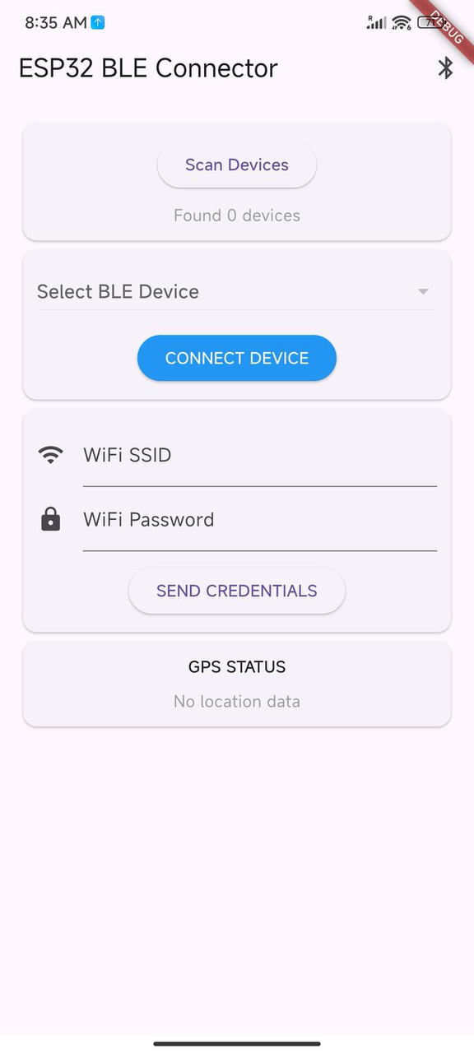
Software Setup
ALIGNED
An APP was designed for IOS, Andorid and Web
The Device can be initilized throgh the APP “ESP32-Connector” with Wi-Fi and GPS info
As they are initilized, no need re-init for Devices

Slide 17
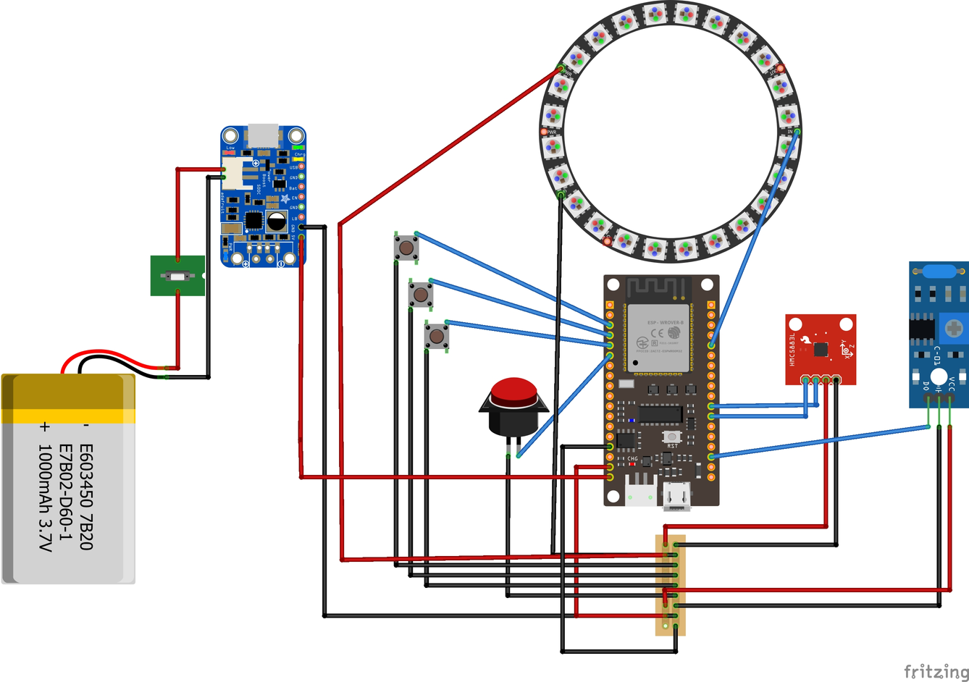
Hardware Setup
Hardware:
Buttons
ESP_WROOM32
HMC5883L
Vibrator
NeoPixel Ring
Battery module

Slide 18
Enclosure Design

Slide 19
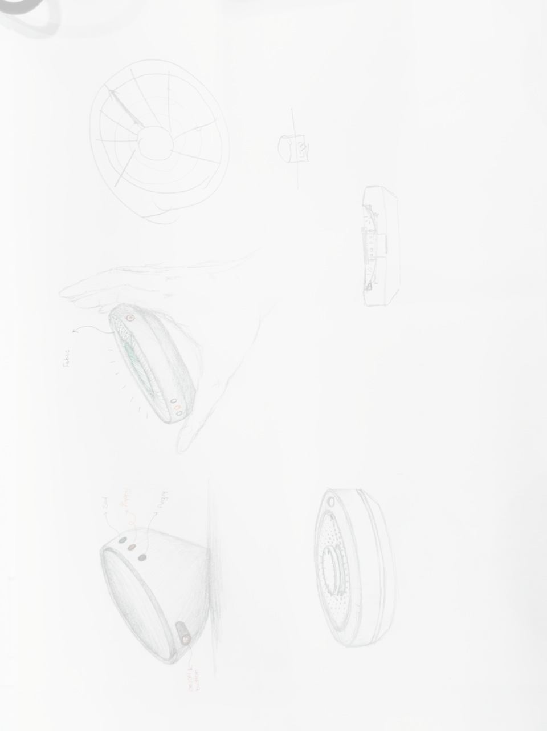
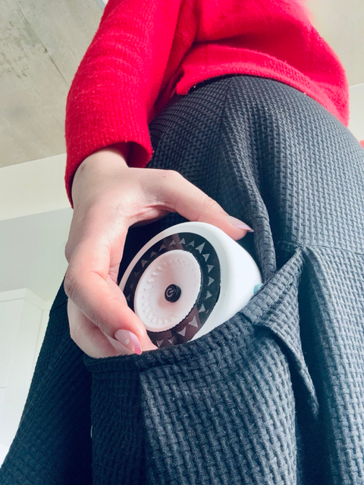
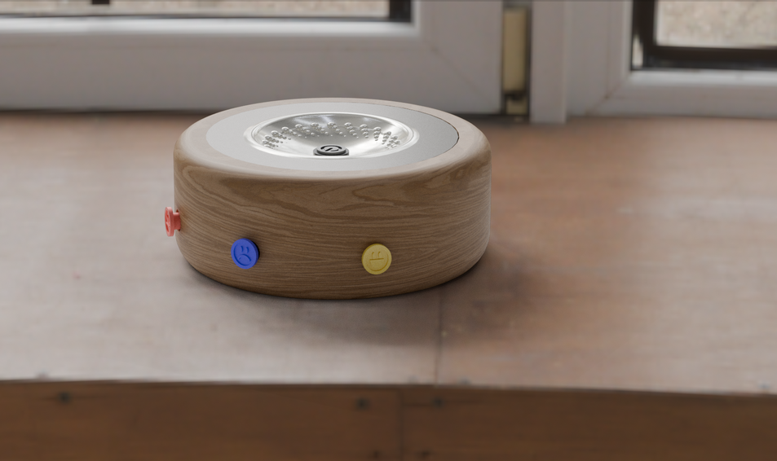
Design Principals
1
2
3
Small and pocket size
Easy to use and intuitive
Beautiful and slick
It ought to be a wireless and portable device that can be easily and comfortably held in your hand.
The interface should be very straight forward to use and it should be fairly easy to follow the signs and colors
It ought to be pleasing to the eyes and preferably customizable
NEXT
2025
Aligned

Slide 20
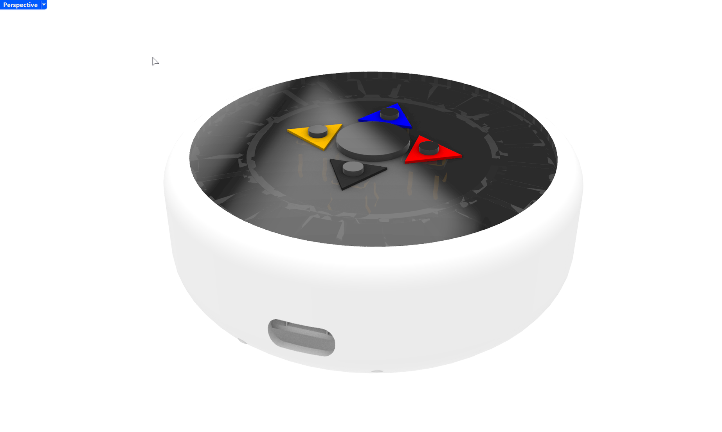
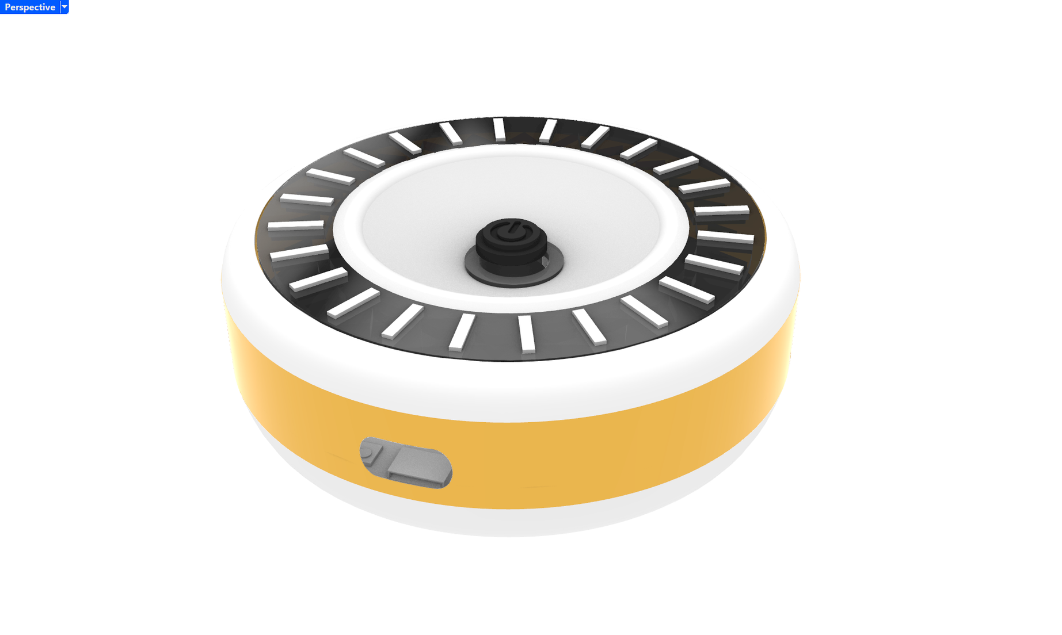
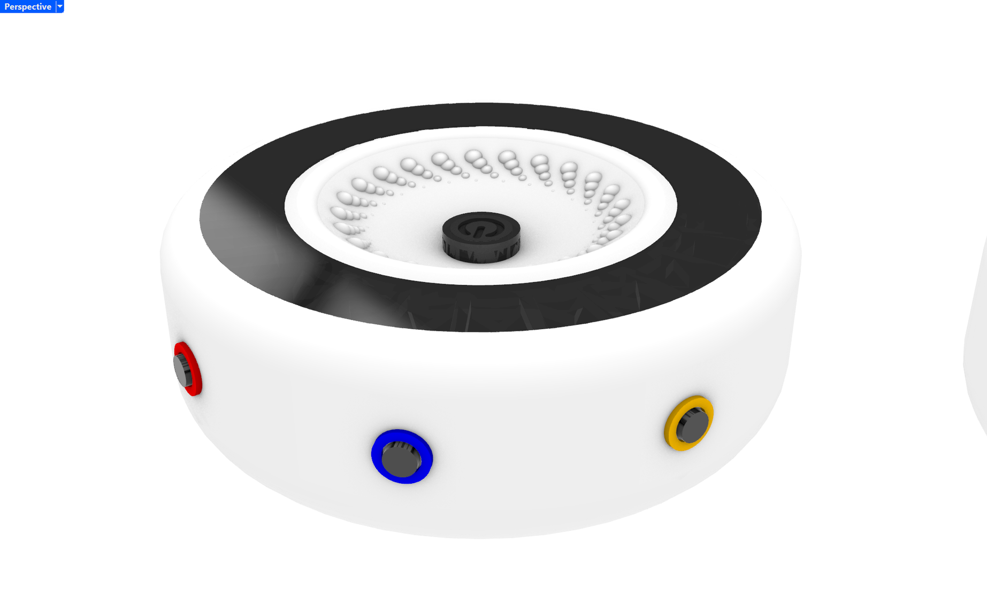
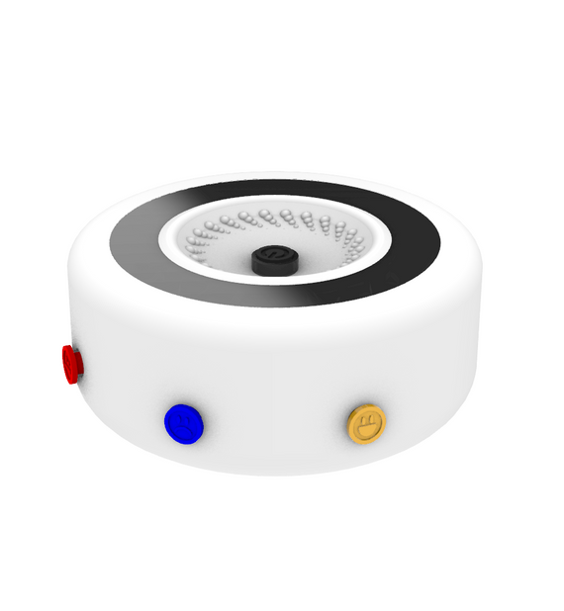
Enclosure Modeling
There are Four distinct versions of the enclosure, each tailored for size and user-friendliness.
1
2
3
4
Seamless integration with buttons
Adding physical signifiers
Buttons on the side + details
Changing the Height and size
NEXT
2025
Aligned

Slide 21
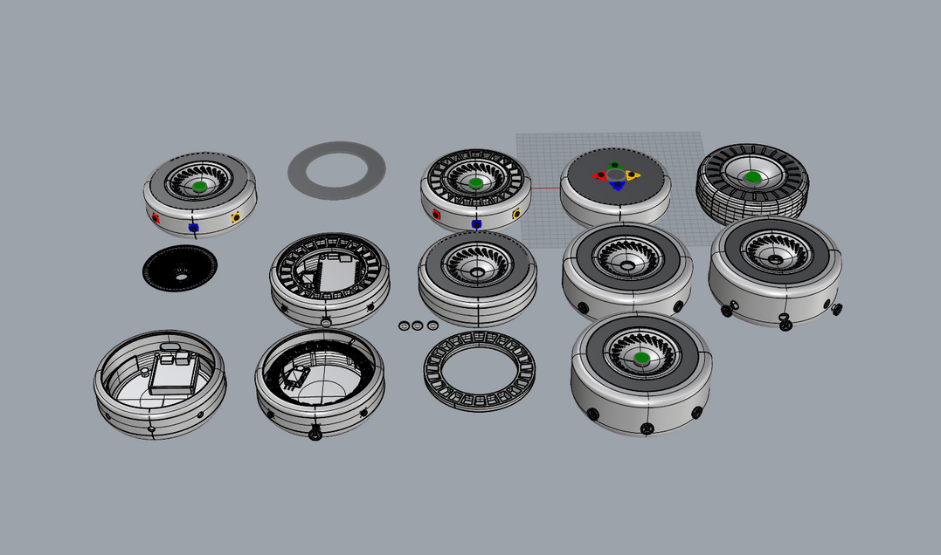
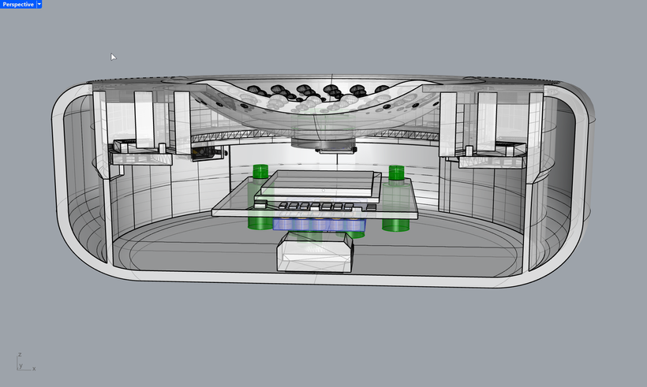
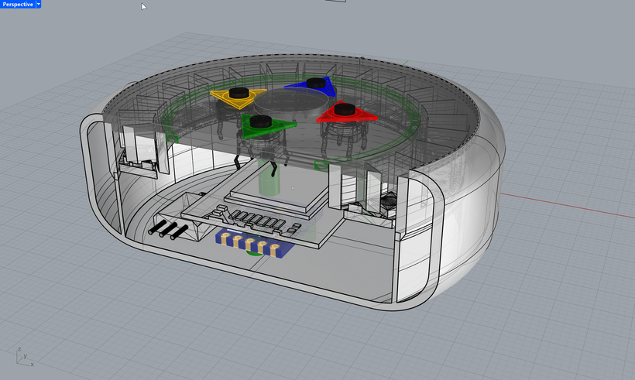
The Challenges
1
Efficient arrangement of all the components in small space
2
Including the battery and the charger module
3
The fixings and accessibility to the Key components
NEXT
2025
Aligned

Slide 22
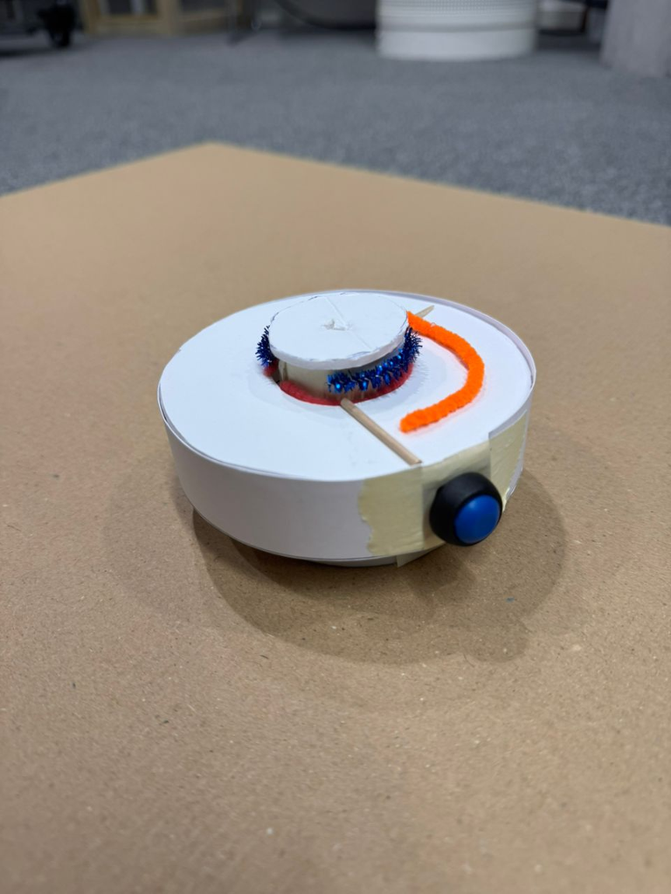
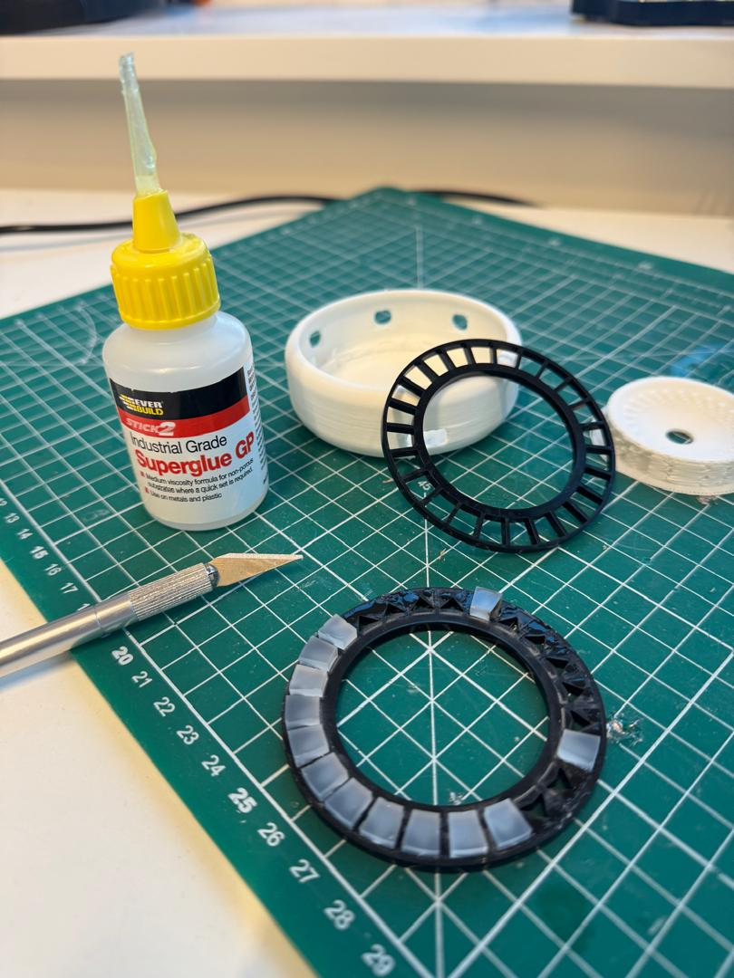
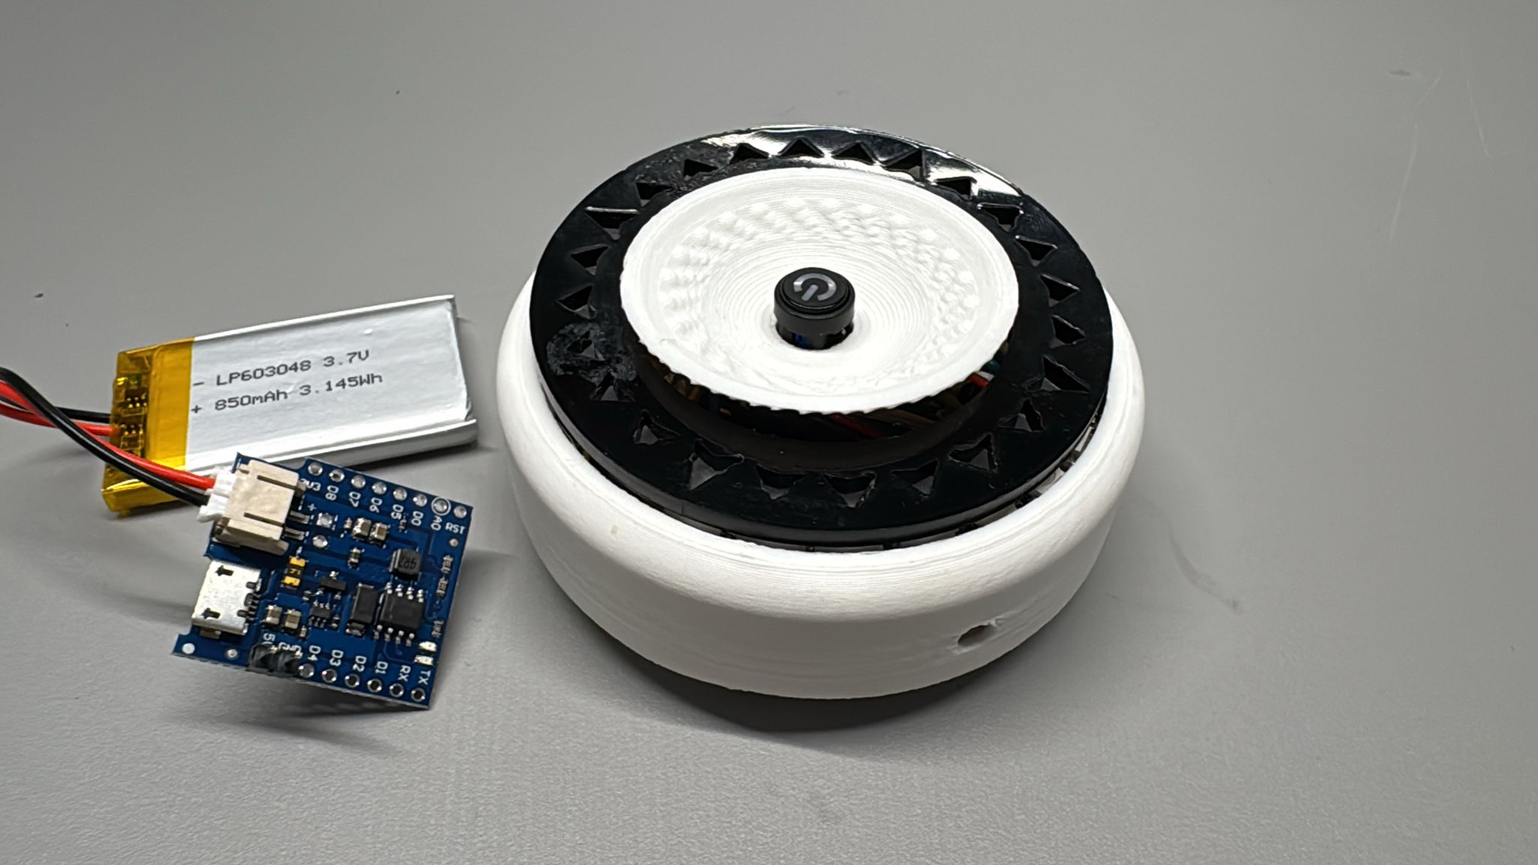
Prototype
Developments
Initial Paper
Prototype
Testing Acrylic diffuser
Refined Prototype
Final Prototype
NEXT
2025
Aligned

Slide 23
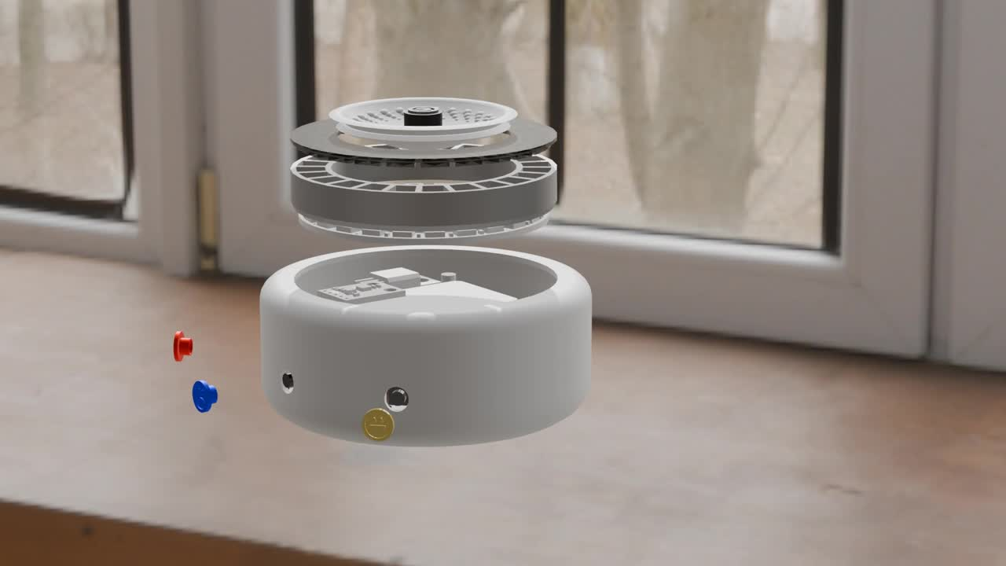
Aligned Explosion

Slide 24

Limitation
Batteries do not provide power for too long
Circuit integrated with many wires
Circuit Heat Dissipation & lose connection
long-distance range
09

Slide 25
Future Development
Using PCB instead wire-based circuit
Enrich emotional expression
Better app UI/UX to enhance user experience
Instead of 1 - 1 device, 1 - mutilple devices

Slide 26
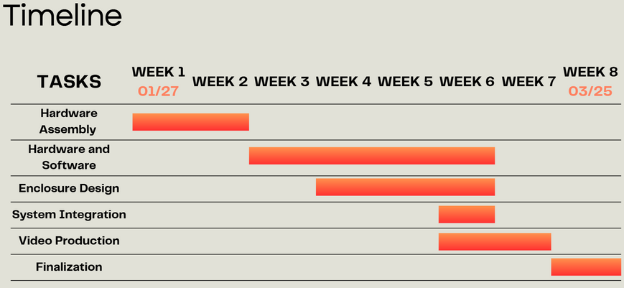
Reflection
ALIGNED
More experience in team work
Skills development (Design & Hardware & Software & communication)
Clear DDL setting and work distribution
Feasible changes towards overall objectives
Creative “plan B”
Achieve all the target functions

Slide 27

REFERENCES
07

Slide 28
Chien, W.-C., & Bardzell, J. (2017). Technology-mediated relationship maintenance in romantic long-distance relationships: An autoethnographical research through design. Proceedings of the 2017 CHI Conference on Human Factors in Computing Systems (pp. 4873-4884).
Ishii, H., & Ullmer, B. (2021). Tangible interfaces for ambient intimacy:
Light-based communication in distant friendships. *Proceedings of the ACM on Human-Computer Interaction*, 5(CSCW2), 1-24.
Wilson, T.D., & Brooks, R.L. (2020). Silent connections: How ambient technologies reshape paternal bonds. *Journal of Family Psychology, 34*(8), 1123-1135.
https://www.suunto.com/en-gb/Product-search/See-all-compasses/
https://en.lovebox.love/
https://feelhey.com/

Slide 29

Thank you !

